Slide 1

Cultural Transformation
Microsoft Virtual Internship
Template
Research the cultural transformation journey that Microsoft has been through.
Identify the key elements of Microsoft’s current culture driven by Satya Nadella (CEO).
Answer the following three questions (one per slide):
How has Microsoft’s culture transformed?
What are the key elements of the current culture?
What inspires you about Microsoft’s culture?

Slide 2
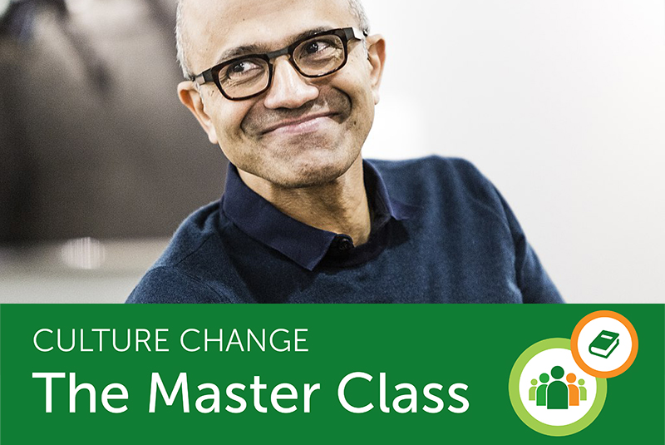
1. How has Microsoft’s culture transformed?
Microsoft Virtual Internship
Even one of the most valuable companies on Earth knows how hard it can be to shift a culture.
From attitude to outcomes : Microsoft’s journey with the NeuroLeadership Institute began with growth mindset, the belief that skills are improvable; they aren’t set in stone. CEO Satya Nadella professed that his company need to become one of “learn-it-alls,” not know-it-alls. People needed to see themselves, and the organization, as more fluid entities. The focus was on improving, not proving, themselves.
Impact you can see — and hear: As we note in “How Culture Change Really Happens,” “when we blend the new behavior with current activities, it’s easier to latch on to, which makes it become an unconscious behavior more quickly.”Microsoft used this approach to overhaul its leadership framework. But organizations of any size can use the framework to revamp all aspects of culture, from the broadest performance processes down to the subtlest biases.

Slide 3
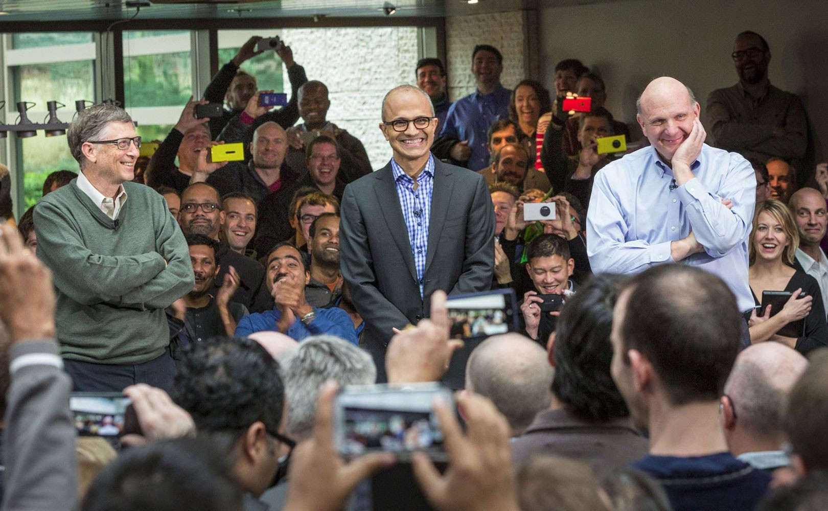

2. What are the key elements of the current culture?
Microsoft Virtual Internship
Companies have distinct cultural characteristics based on the nature of their businesses, industry situation, labor market conditions, and internal business processes. Microsoft Corporation’s organizational culture has the following main characteristics:
Accountability : Microsoft describes its corporate culture as a culture of accountability. This cultural feature ensures that every employee understands that his actions have consequences in the company’s context
Quality and Innovation: As a technology business, Microsoft needs to innovate to maintain its competitiveness against other computer hardware and software firms.
Responsiveness to Customers: To ensure customer satisfaction, Microsoft Corporation includes responsiveness as a feature in its organizational culture.
Growth Mindset: Growth is a necessary part of every business. Microsoft uses its corporate culture to grow its computer hardware and software business.
Diversity and Inclusion: Diversity and inclusion is now seen as an essential factor in business development. Microsoft applies these factors in its organizational culture through appropriate training programs.

Slide 4

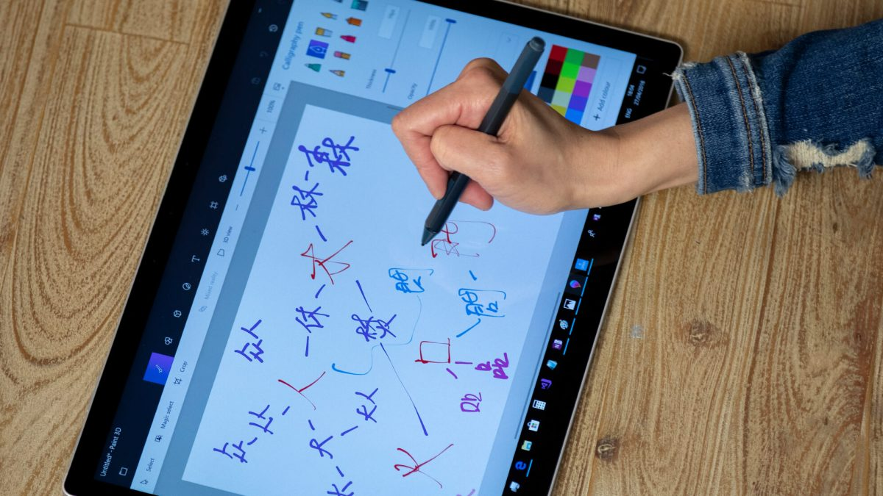
3. What inspires you about Microsoft’s culture?
Microsoft Virtual Internship
It’s deeper than curiosity, more powerful than interest or a hunger for learning. Passion is what drives these innovators to improve their corner of the world.
According to Nadella, when a company is successful, the product that makes it successful, the capability around that product and the culture get locked together. This makes it difficult to adopt new products or concepts. “It’s one of the classic issues with all of us in business,” he said. “When you have a business that’s growing super well, it’s got great gross margins, you don’t look around and say, ‘Oh, here is another business that’s got crummy growth margins and that’s what we should do next.That’s when culture will matter, because the culture cannot fight the creation of that new concept.”
Because of that employee’s story, I felt support from Microsoft’s culture and decided it was time for me to come out. Had I worked at another company, maybe I wouldn’t have done it yet, but Microsoft was different.

